Slide 1
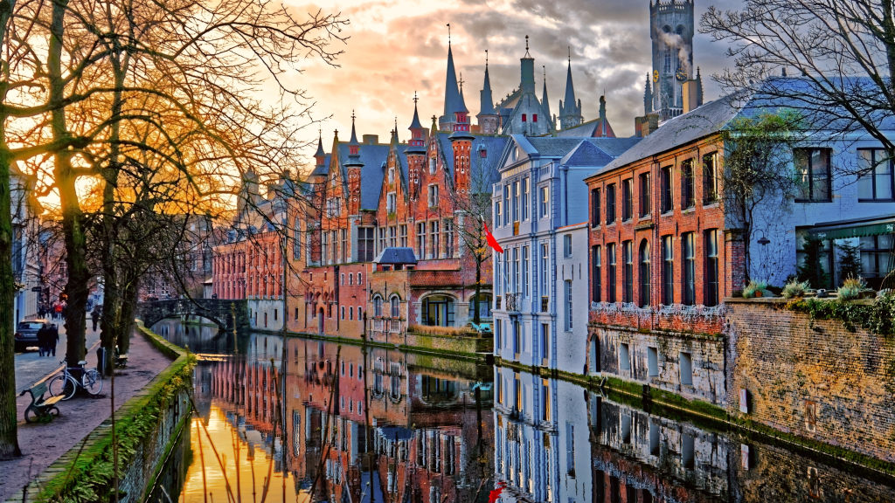



50th IST Ops & 77th SSC meeting in Bruges, Belgium
22 - 26 September 2025

Slide 2
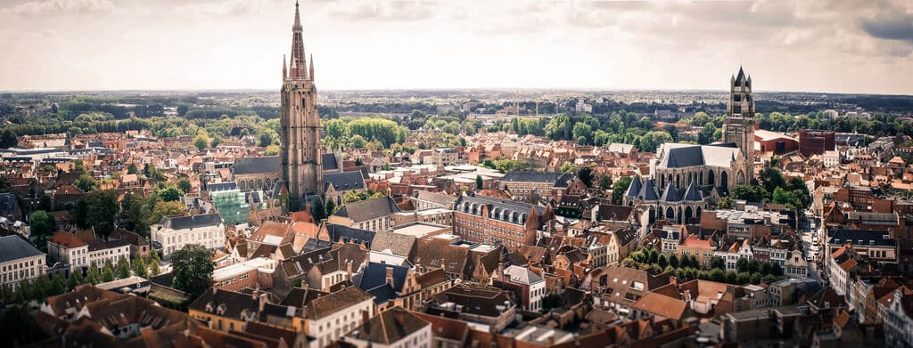
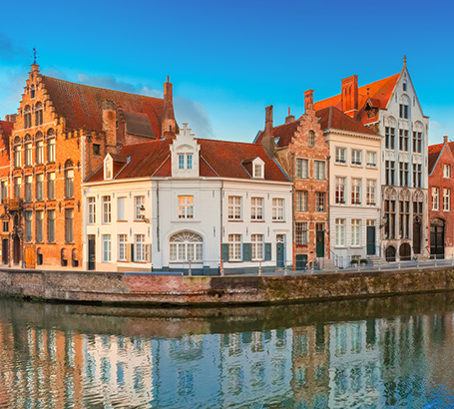
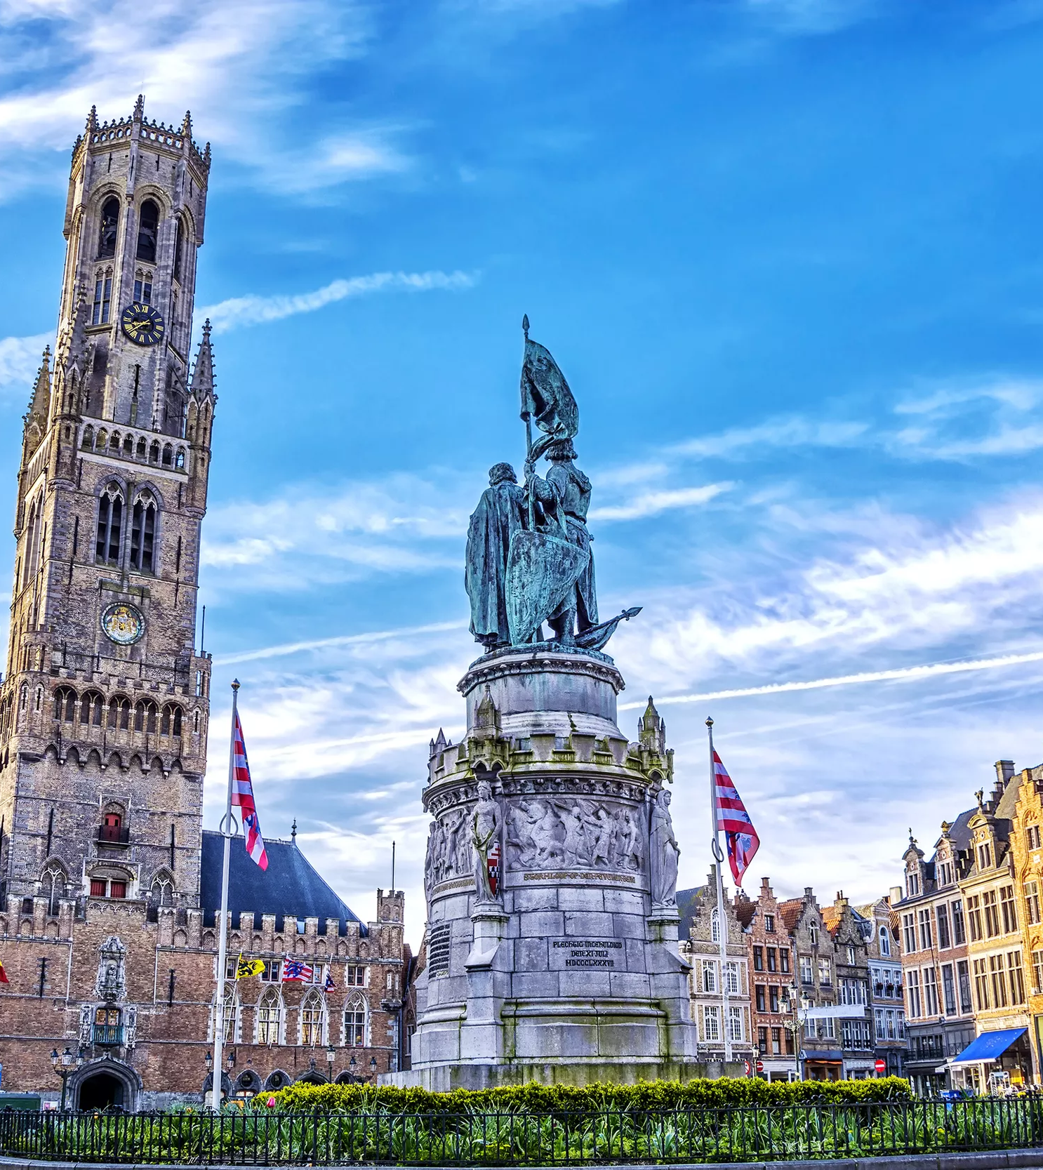
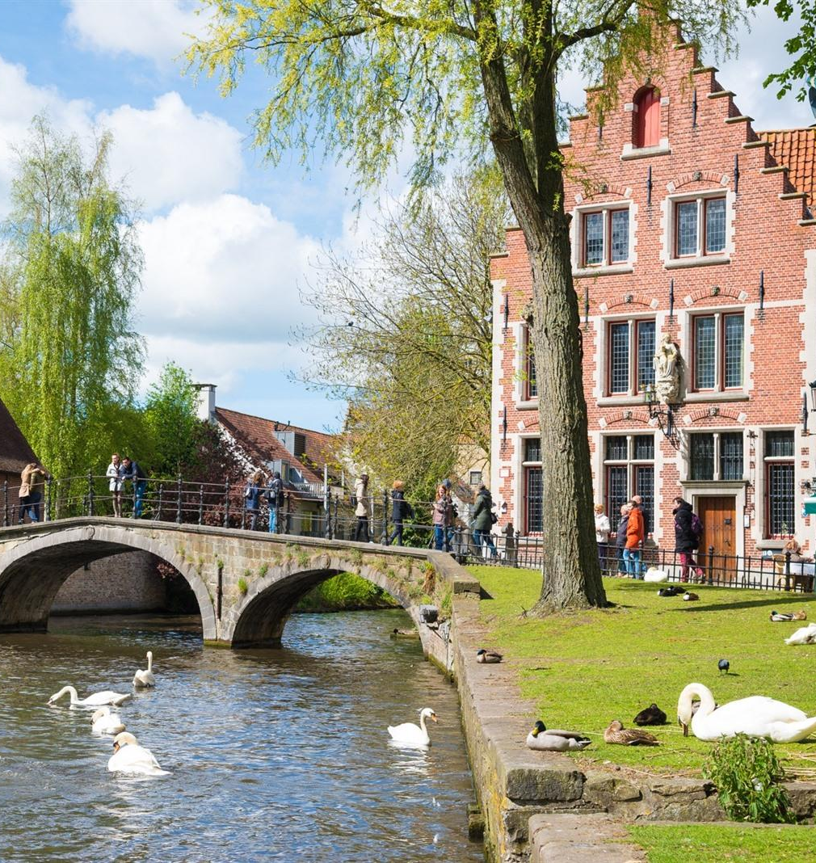
The Belgian Defence is honored to welcome you to the medieval heart of Bruges, where advanced Multinational Cooperation in Strategic Mobility meets the Timeless Charm of this Historic city.

Slide 3
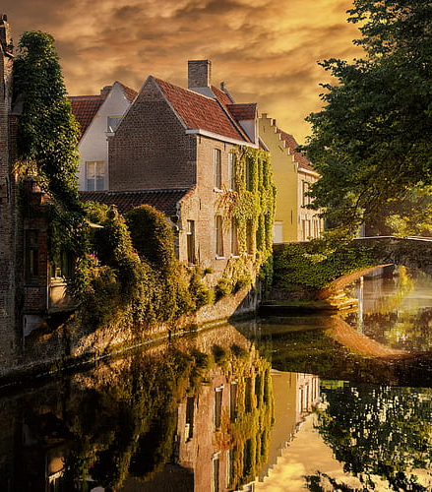
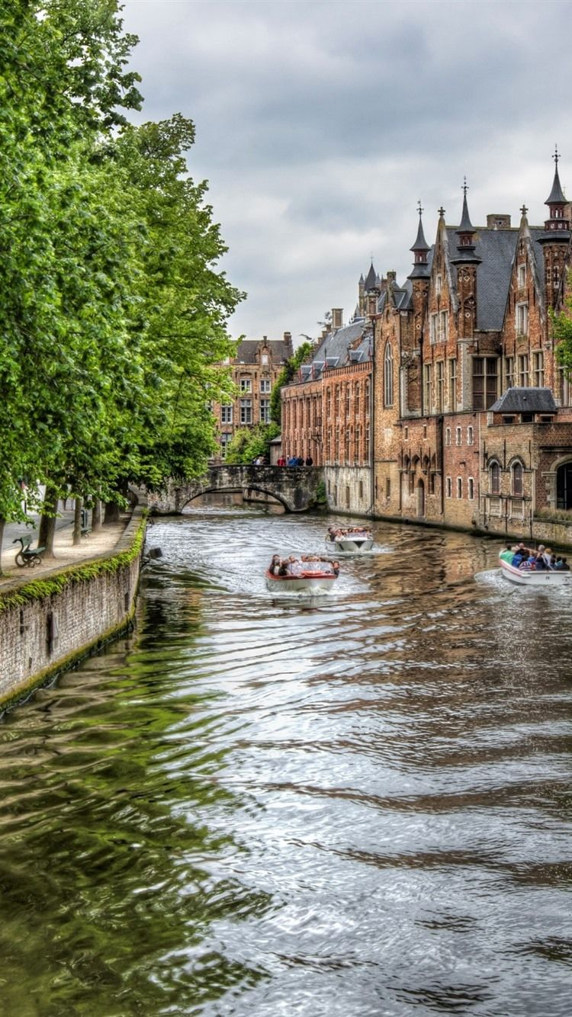
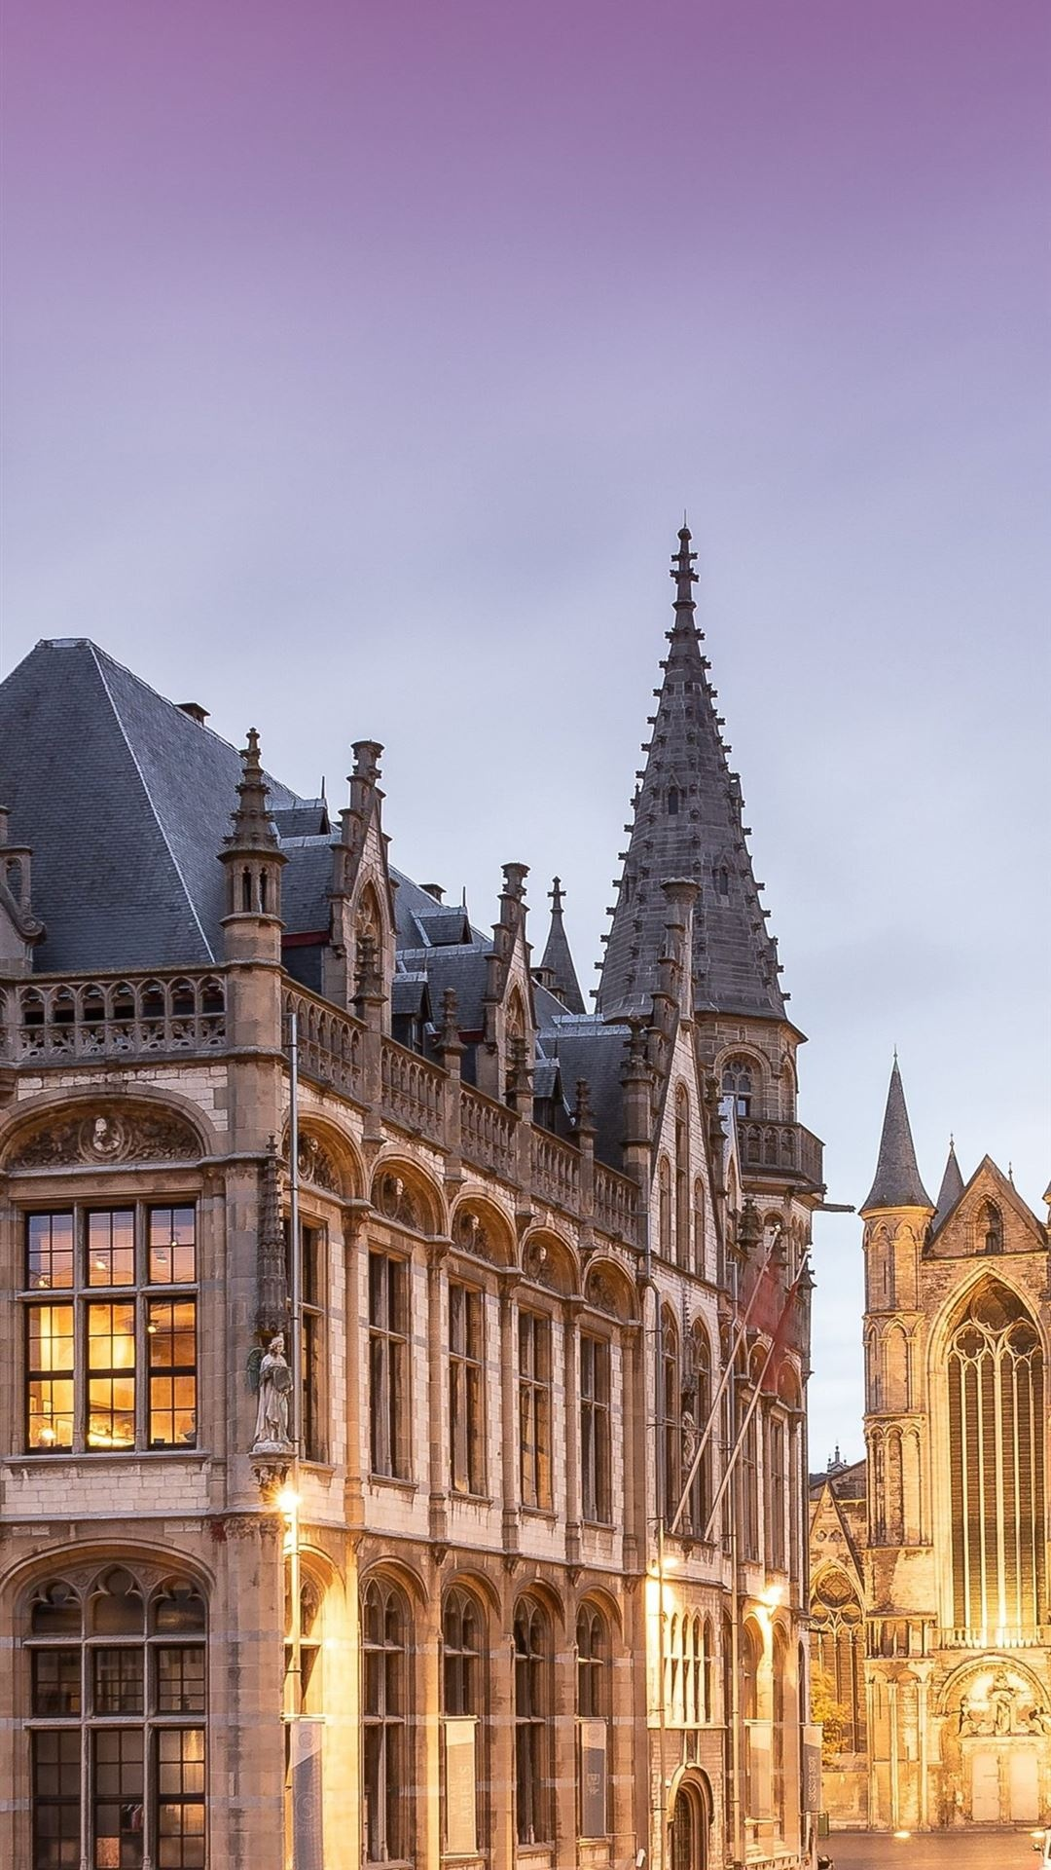
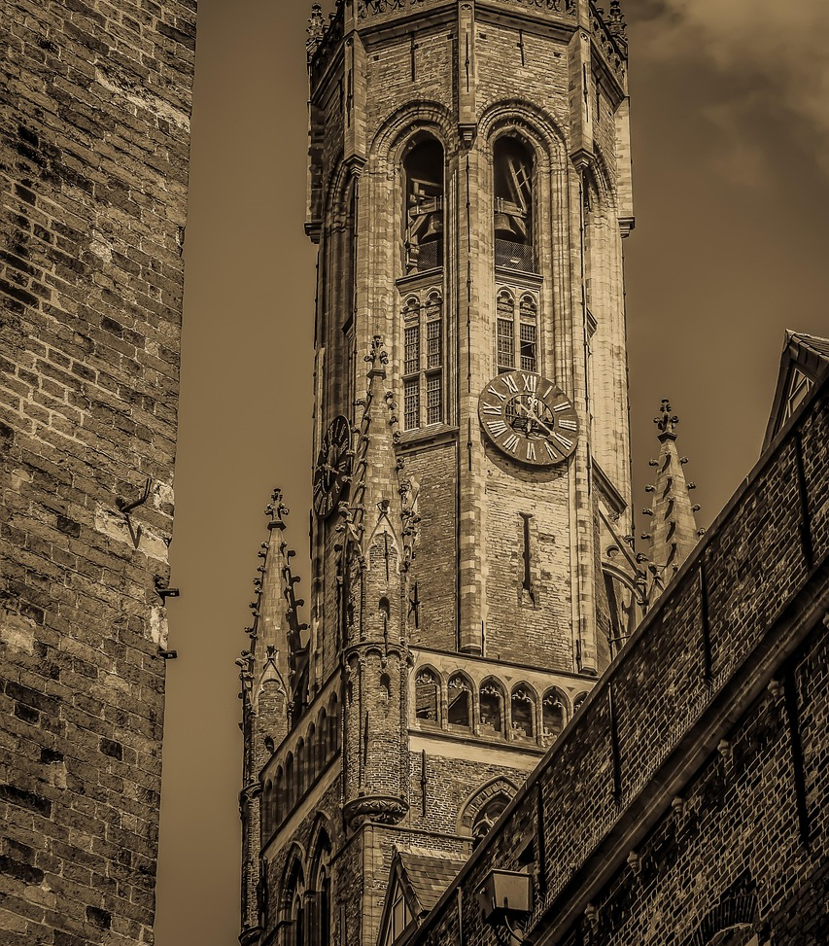
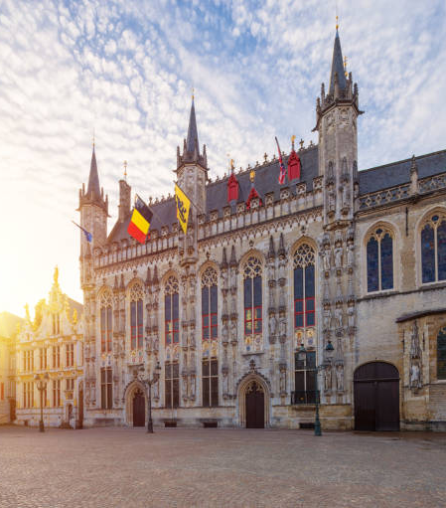
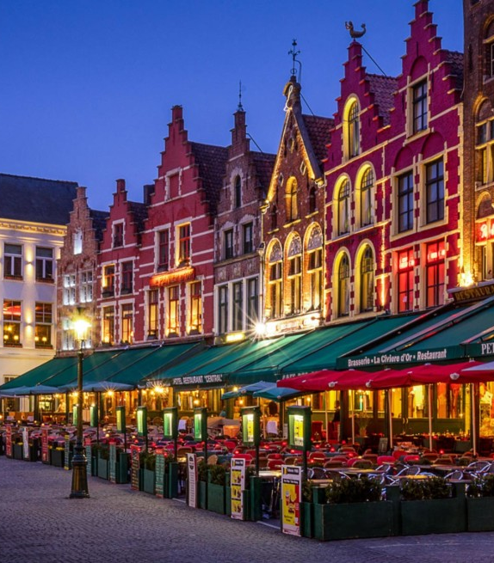
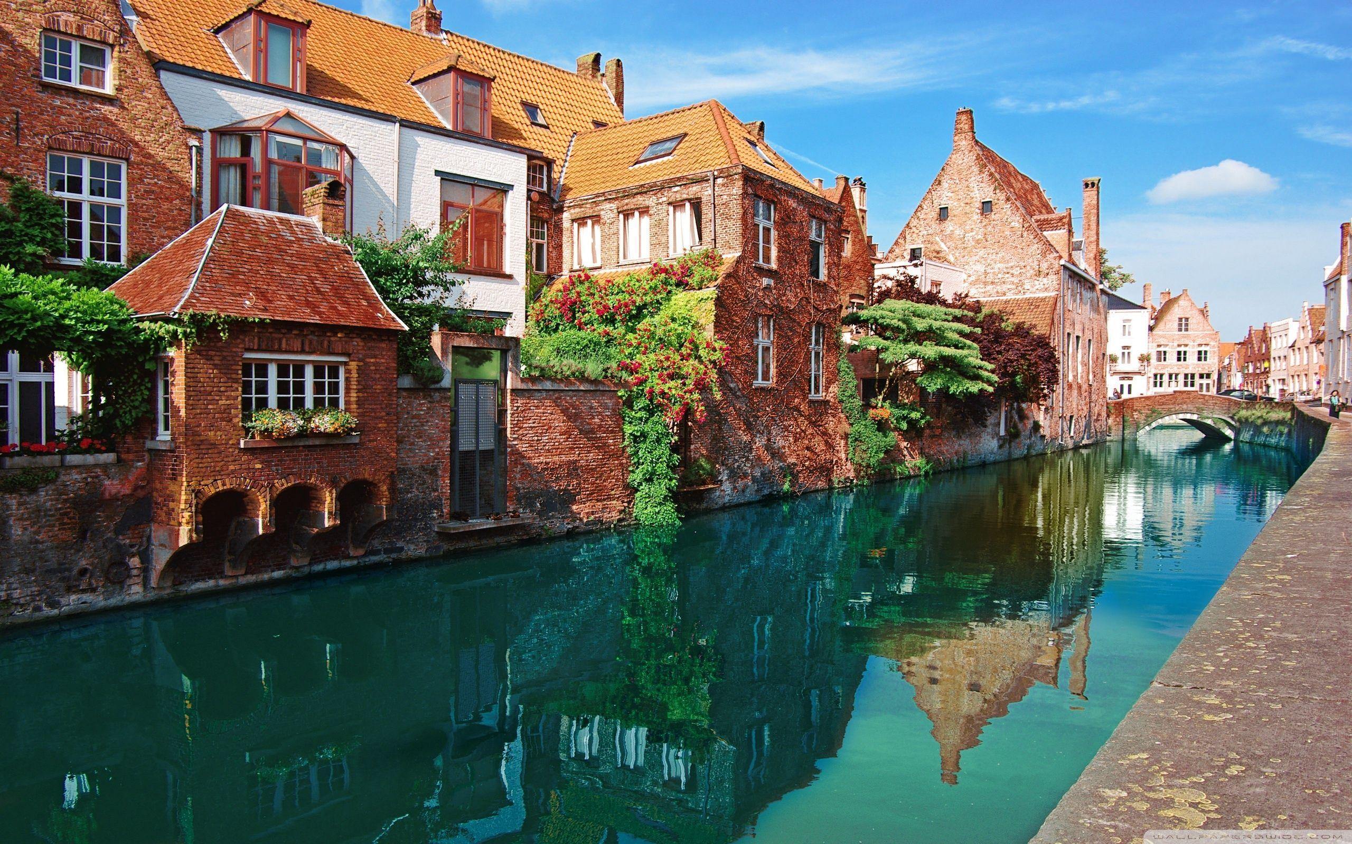
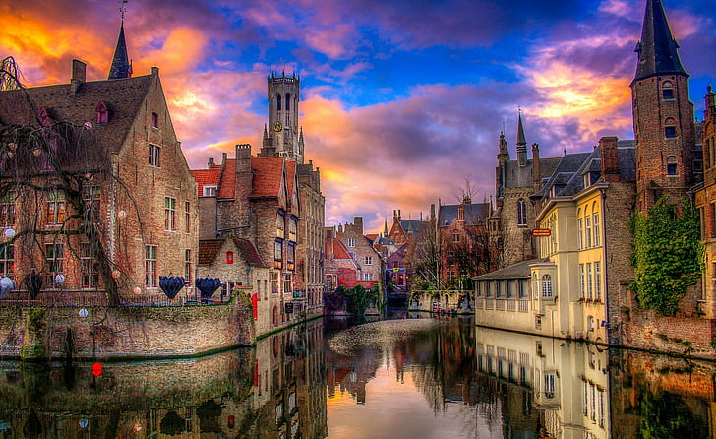
Bruges is a beautiful medieval city almost untouched by time.
If you like jazz, you will be well catered for.
If you like chocolate and beer, you will be in heaven.

Slide 4



How to reach the historic center of Bruges
Of the four Belgian airports, Brussels Airport Zaventem and Ostend-Bruges International Airport are the two best options for traveling to Bruges. These airports offer the most convenient connections to the historic city of Bruges.
Brussels South Charleroi Airport is an alternative, but it is not recommended due to its poor public transport links.
From Brussels Airport Zaventem:
Hourly direct trains to Bruges depart from the station beneath the terminal. Alternatively, take first a train to Brussels North, Brussels Central or Brussels South (midi/Zuid) and transfer to a train heading to Ostend, Knokke or Blankenberge.
Total travel time is about 1 hour and 30 min.
From Ostend-Bruges International Airport:
Bus number 60 departs from the “Raversijde Luchthaven” stop, right in front of the terminal, and takes you to Ostend Station in just 20 min. From here, three trains per hour go directly to Bruges. The ride takes about 15 min.
When taking the train to Bruges, be sure to choose 'Bruges' station and not 'Bruges-Saint-Pierre’.
For exact travel times and ticket prices, you can always use the journey planner of the national railway company.
Another option to reach the picturesque city of Bruges from the airports is by rental car or taxi, offering flexibility and a direct route to the historic center. The best choice by taxi is to be dropped off directly at the hotel.
When travelling by rental car please note that a low-traffic zone is in effect in the city center.

Slide 5


How to reach the historic center of Bruges from the station
Upon arriving at Bruges Station, take bus number 1 or 2 (every 5 min) from platform A1 and get off at the
“Brugge Dijver” stop. The hotel is just a 350-meter walk from there. A bus ticket costs €3.
For live departure times, you can check the bus company’s journey planner.
Another option is the free shuttle bus (every 25 min) that connects the station with the city center.
To take it, board at the station and ride it to the “Brugge Dijver” stop.
From there, it's a 350-meter walk to the hotel.
As fit military personnel, a 1.7 km walk through the heart of historic Bruges is, of course, a suitable alternative.
For those traveling by (rental) car, the hotel offers parking (limited places) at €30/24 hr. (pre-booking is needed)
Alternatively, you can use the station parking, which is the most affordable in the city at €7/24hr including a free bus ticket.
From there, use one of the previous options to reach the hotel.

Slide 6
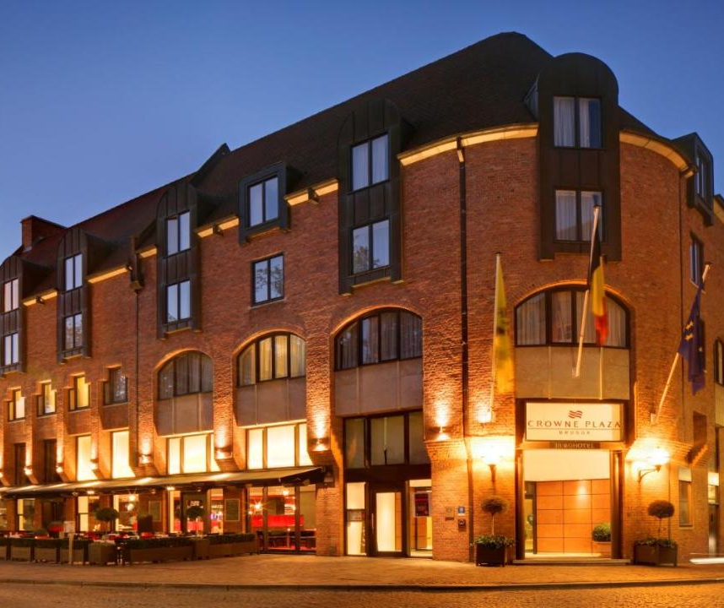
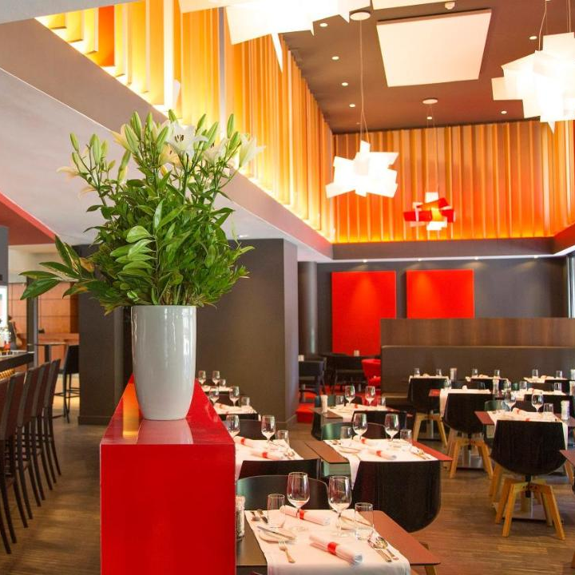
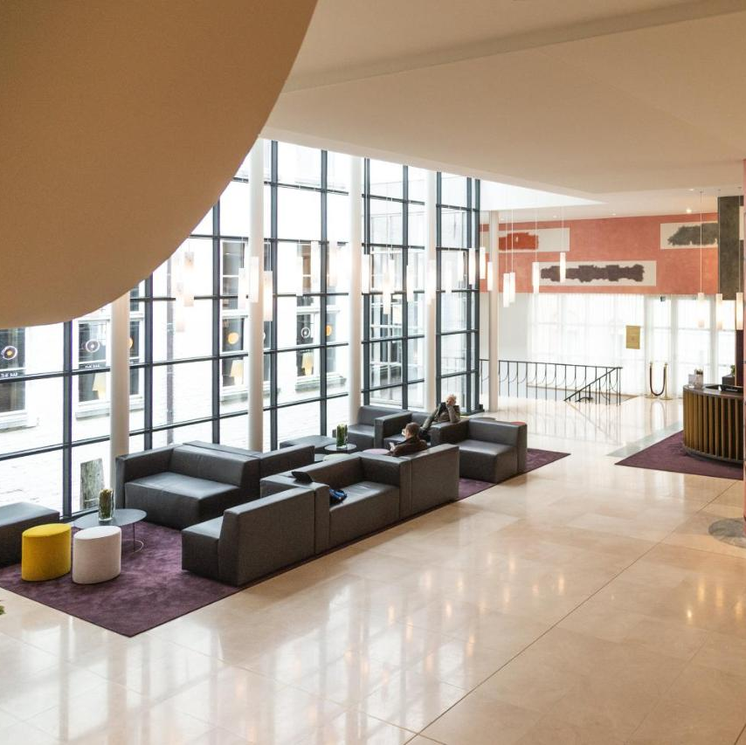
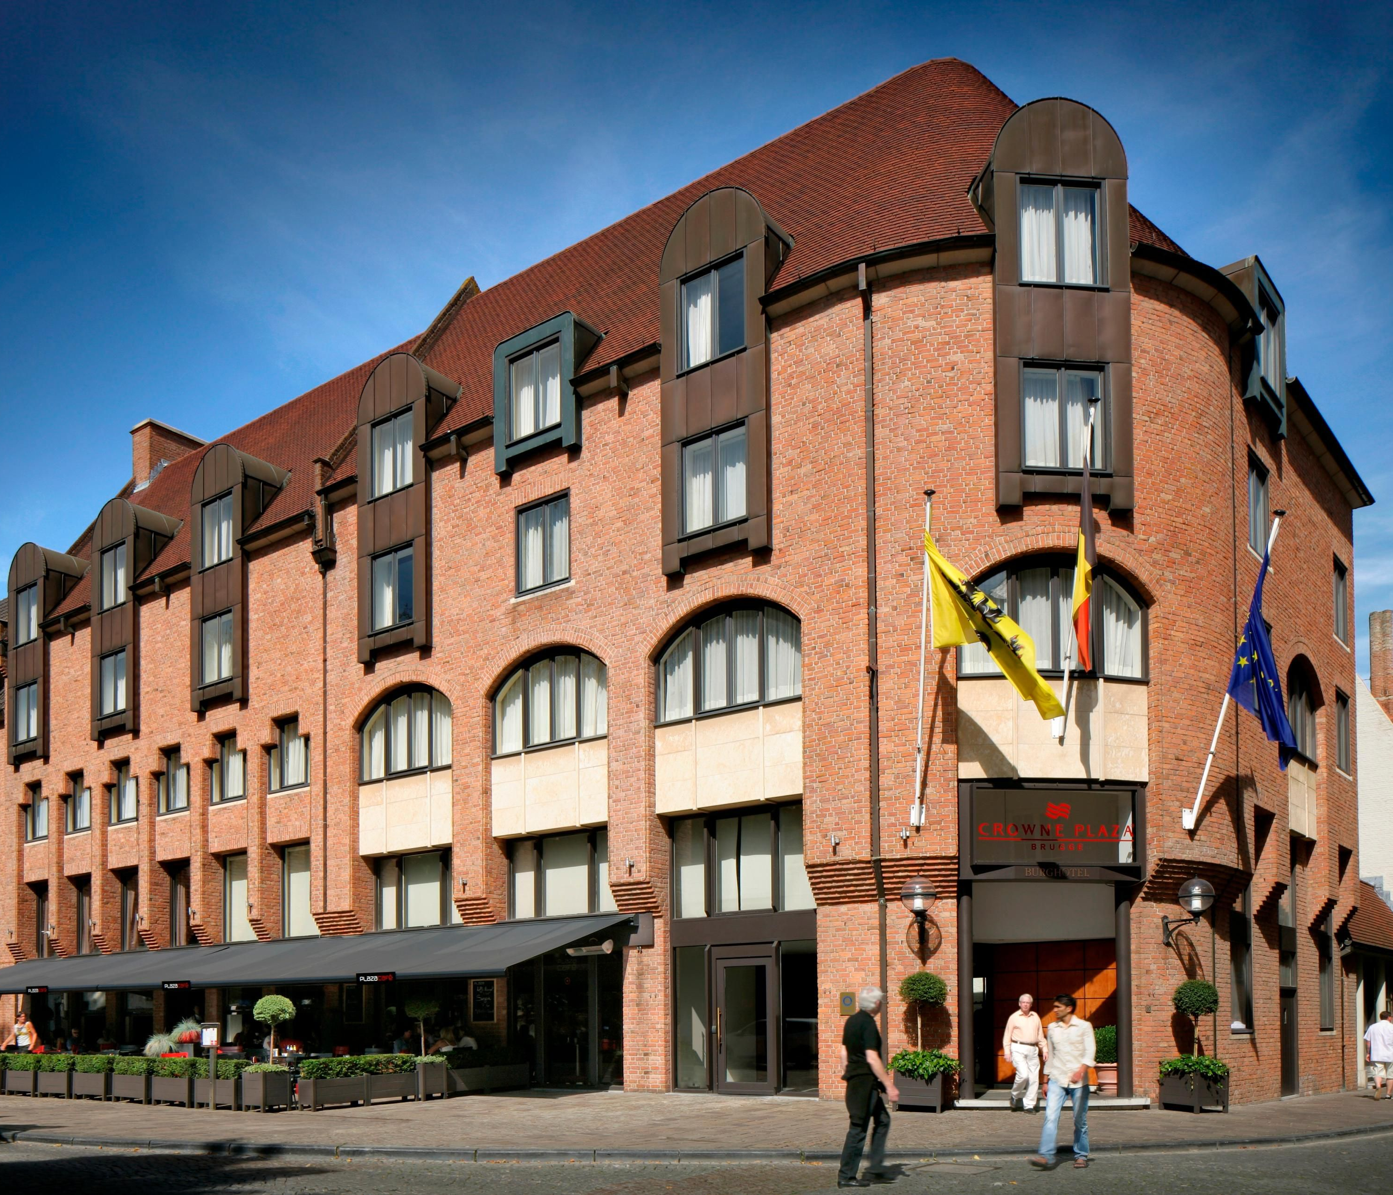
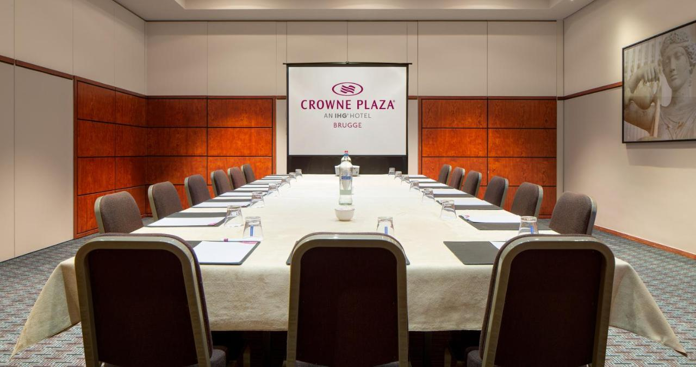
The Crown Plaza hotel
Located in the enchanting heart of Bruges, the accommodation and meeting venue offers us an exquisite blend of modern comfort and timeless charm. The hotel lies just a short stroll from the renowned Belfry of Bruges and is directly opposite the majestic medieval Town Hall, offering a perfect backdrop for both business and leisure.
Adres: Burg 10, 8000 Bruges

Slide 7

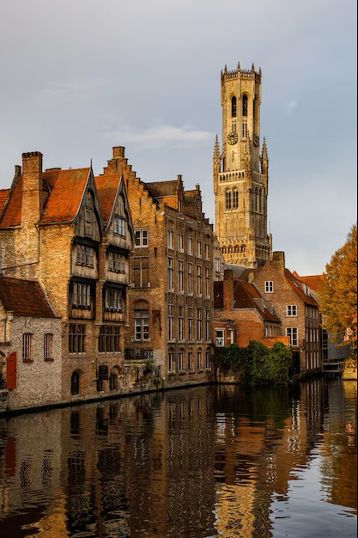

Social events
Monday
22/09/2025
Icebreaker in the Historic Residence of the Military Commander of the province of West Flanders.
Tuesday
23/09/2025
Expert-guided City Tour of Bruges, ending with a mayoral reception in the Gothic chamber of the Historic City hall.
______
Hosted dinner
Wednesday 24/09/2025
Icebreaker in the Historic Residence of the Military Commander of the province of West Flanders.
Thursday
25/09/2025
Guided Tour and Tasting Experience at the Historic Halve Maan Brewery.
______
Hosted dinner

Slide 8
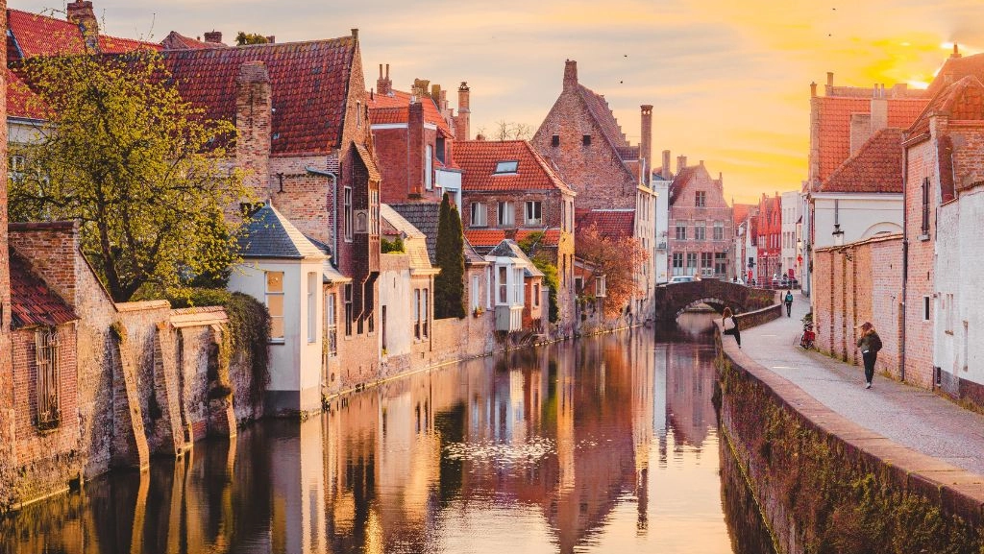

Bruges is like an old book whose pages cannot be easily turned. Every street, every corner tells its own story.
~
Louis Paul Boon 1912-1979
(Belgian writer)
If you have any questions please don’t hesitate to contact:
Tom.ceunen@mil.be
or
ist@mcce-mil.com / sealift@mcce-mil.com

