Slide 1
xx Sep 2025
Name
Rank
Position

Slide 2
OVERVIEW
National offer/requests (excel format)
National IST assets / national transport contracts / Host Nation Support and possible offers to other nations
NMCC structure and POC details update
Exercises: Questionnaire exercises (excel format)
Sharing of experience from conducted IST movements/transports (LI/LL)
Missions planned sustainment transports - timetable
All other business
01
02
03
04
05
06
06
07

Slide 3
50th IST Ops Meeting
Sep 2025, Bruges, BEL
FLAG
Country name
The worksheets are available as the attachment to the mail
01
National offers – national requests
National offer
From |  | To |  | MoT |  | Timeframe |  | Name of the exercise / mission / remarks
Place | Country | Place | Country | Rail | Road | from | until

Slide 4
50th IST Ops Meeting
Sep 2025, Bruges, BEL
FLAG
Country name
The worksheets are available as the attachment to the mail
National offers – national requests
01
National request
From |  | To |  | MoT |  | Timeframe |  | Name of the exercise / mission
Place | Country | Place | Country | Rail | Road | from | until

Slide 5
50th IST Ops Meeting
Sep 2025, Bruges, BEL
FLAG
Country name
02
Exercises: Questionnaire exercises (excel format)
Please inform us about
Exercises in which your nation will participate, with possible deployment and redeployment via IST/ST.
To analyse the information collected, please send us the updates NLT 12 SEP 2025 and we will be able to present an overview during the IST OPS sessions.
Please use the Excel form or the 50. IST Ops Meeting - National Offers- National Requests-Questionnaire Exercises-Operations template
The worksheets are available as the attachment to the mail

Slide 6
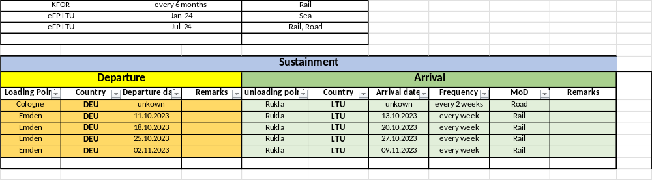
50th IST Ops Meeting
Sep 2025, Bruges, BEL
FLAG
Country name
If possible, please also include the planned sustainment transports as a timetable.
03
The worksheets are available as the attachment to the mail
Missions planned sustainment transports - timetable
example

Slide 7
50th IST Ops Meeting
Sep 2025, Bruges, BEL
FLAG
Country name
4. National IST assets / national transport contracts / Host Nation Support and possible offers to other nations
04
Please let us know if there are any changes to the national actual assets.
Is your nation planning any procurements in the near future for which you would like to obtain experience from other nations?
Furthermore, there are changes for the use by other MCCE Member States of contract opportunities (transport, storage...).
Are there usable Log Hubs in your nation (location)?

Slide 8
50th IST Ops Meeting
Sep 2025, Bruges, BEL
FLAG
Country name
5. Sharing of experience from conducted IST movements/transports
05
Please let us know any LI or LL you would like to share with the IST community, (e.g. customs, Log Hub characteristics, multimodal transports, security issues, …).

Slide 9
50th IST Ops Meeting
Sep 2025, Bruges, BEL
FLAG
Country name
6. NMCC structure and POC details update
06
Please let us know how we can reach you and if there are any changes.

Slide 10
50th IST Ops Meeting
Sep 2025, Bruges, BEL
FLAG
Country name
8. Any other business
07

