Slide 1
52nd IST OPS meeting, Bucharest, ROM,
15th of September 2026
Rank
Name
Organisation
Nation

Slide 2
52nd IST OPS meeting, Bucharest, 15 September 2026
National offer/requests (excel format)
National IST assets / national transport contracts / Host Nation Support and possible offers to other nations
NMCC structure and POC details update
Exercises: Questionnaire exercises (excel format)
Sharing of experience from conducted IST movements/transports (LI/LL)
Missions planned sustainment transports - timetable
AOB
01
02
03
04
05
06
07

Slide 3
52nd IST OPS meeting, Bucharest, 15 September 2026
The worksheets are available in the download area event manager
01
National offers – national requests
National offer
From |  | To |  | MoT |  | Timeframe |  | Name of the exercise / mission / remarks
Place | Country | Place | Country | Rail | Road | from | until

Slide 4
52nd IST OPS meeting, Bucharest, 15 September 2026
The worksheets are available in the download area event manager
01
National offers – national requests
National request
From |  | To |  | MoT |  | Timeframe |  | Name of the exercise / mission
Place | Country | Place | Country | Rail | Road | from | until

Slide 5
52nd IST OPS meeting, Bucharest, 15 September 2026
02
Exercises: Questionnaire exercises (excel format)
Please inform us about
Exercises in which your nation will participate, with possible deployment and redeployment via IST/ST.
To analyse the information collected, please send us the updates NLT 31 August 2026 and we will be able to present an overview during the IST OPS sessions.
Please use the Excel form or the exercises questionnaire in the MCCE Event’s Manager
52nd IST and 79th ST OPS Meeting webpage

Slide 6
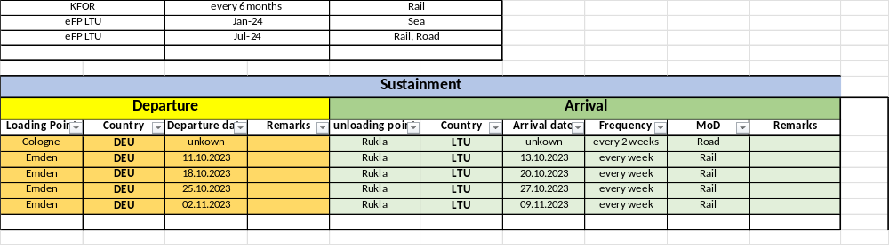
52nd IST OPS meeting, Bucharest, 15 September 2026
03
Missions planned sustainment transports - timetable
If possible, please also include the planned sustainment transports as a timetable.
example

Slide 7
52nd IST OPS meeting, Bucharest, 15 September 2026
04
National IST assets / national transport contracts / Host Nation Support and possible offers to other nations
Please let us know if there are any changes to the national actual assets.
Current status on assets available (e.g. type and number of rail waggons)
Please inform us on existing contracts, usable for other nations.
Is your nation planning any procurements in the near future for which you would like to obtain experience from other nations?
Furthermore, there are changes for the use by other MCCE Member States of contract opportunities (transport, storage...).
Are there usable Log Hubs in your nation (location)?

Slide 8
52nd IST OPS meeting, Bucharest, 15 September 2026
05
Sharing of experience from conducted IST movements/transports
Please let us know any observations, LI or LL you would like to share with the IST community, (e.g. customs, Log Hub characteristics, multimodal transports, security issues, …).

Slide 9
52nd IST OPS meeting, Bucharest, 15 September 2026
06
NMCC structure and POC details update
Please let us know how we can reach you.

Slide 10
52nd IST OPS meeting, Bucharest, 15 September 2026
07
Any other information

Slide 11


































Flags

